Slide 1
Interim Presentation
Project 1
Ezra Weible
18 February 2026

Slide 2
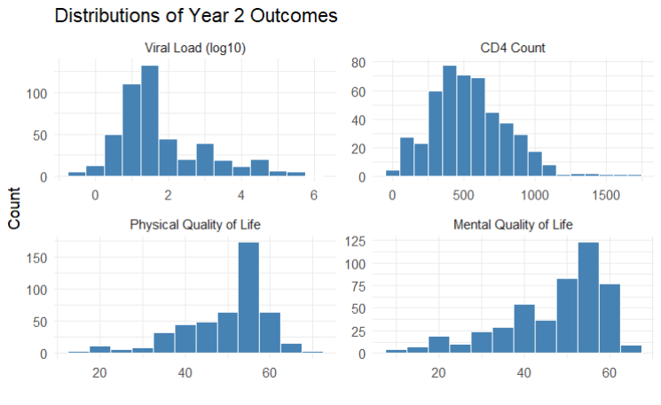
Research Question
Does baseline hard drug use affect treatment response two years after initiating HAART?
Outcomes: viral load (log10 scale), CD4 count, physical and mental quality of life
Null Hypothesis: No difference in year-2 response between baseline hard drug users and non-users
Clinically meaningful differences:
Viral Load: 0.5 log10 change
CD4 count: 50 cell change
QoL: 2 point change
Notes:
Here I’m looking at whether baseline hard drug use affects how well people respond to HAART two years later.
The outcomes I’m focusing on are viral load on the log10 scale, CD4 count, and physical and mental quality‑of‑life scores. Hard drug use at baseline is the main predictor
The null hypothesis is that there’s no difference in year‑2 outcomes between baseline hard‑drug users and non‑users. I’m also keeping in mind what counts as a clinically meaningful difference: half a log10 for viral load, 50 CD4 cells, and 2 points on the QoL scales.
Figure 1 shows the distributions of the year‑2 outcomes, validating the log10 transformation of viral load

Slide 3
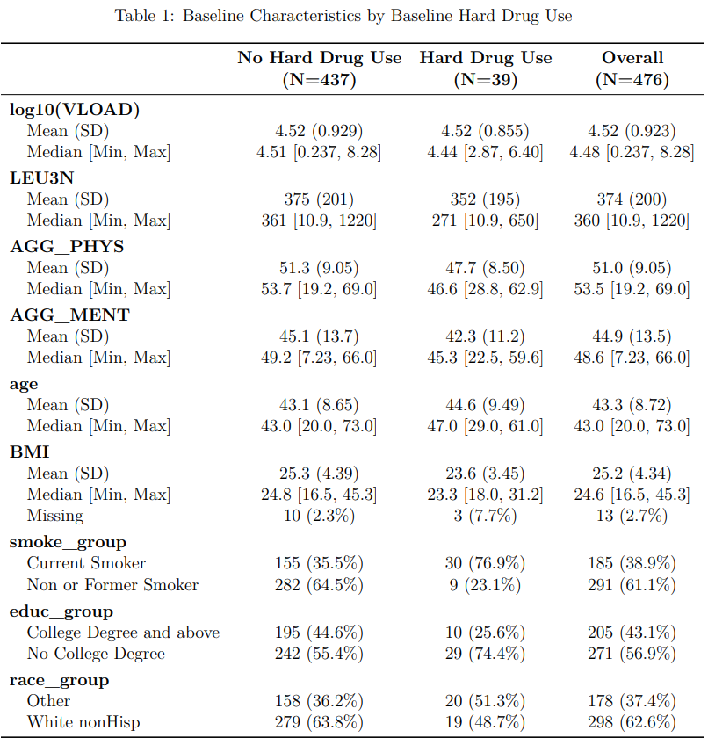
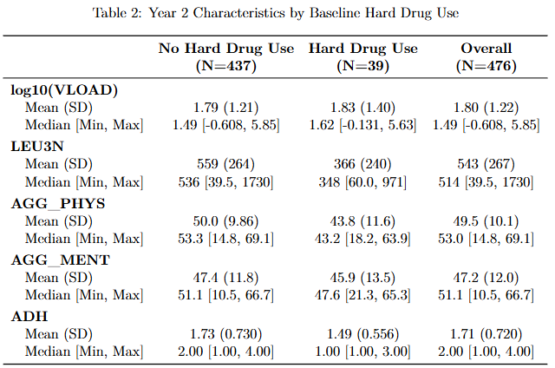
Data Overview
*Collapsed to 2 categories each based on sample sizes
476 subjects had all outcomes for baseline and year 2 and had baseline hard drug use reported
*
* *
Notes:
This dataset includes 476 participants who had complete baseline and year‑2 measurements and reported baseline hard drug use.
A few data issues needed attention: some BMI values were miscoded or implausible, and several categorical variables had very small categories, so I collapsed smoking, education, and race into two groups each.
Baseline characteristics by drug‑use group are summarized in Tables 1 and 2. Viral load is analyzed on the log10 scale, and we’re using complete‑case analysis for each outcome.

Slide 4
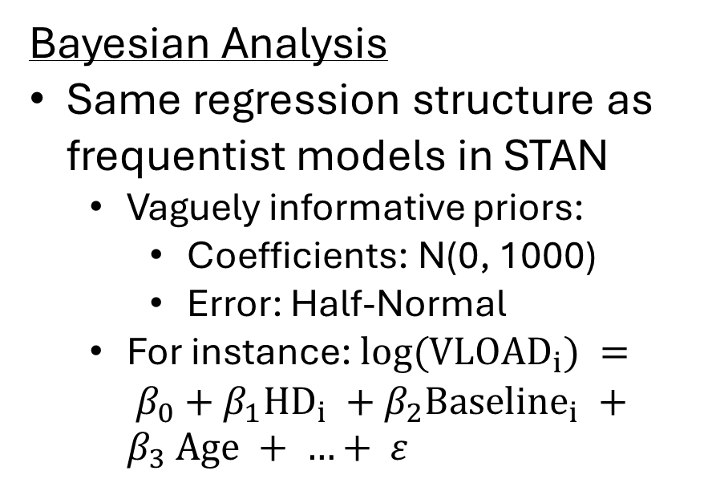
Analysis Plan
Frequentist Analysis
Linear regression of transformed Year‑2 outcome
Predictors (Baseline): hard drug use, outcome, age, BMI, smoking, education, race/ethnicity
Adherence to explore mediation
Bayesian Analysis
Same regression structure as frequentist models in STAN
Vaguely informative priors:
Coefficients: N(0, 1000)
Error: Half‑Normal
For instance: $log({VLOAD}_{i}) = β_{0}+β_{1}{HD}_{i} +β_{2}{Baseline}_{i} +β_{3} Age + …+ ε$
Notes:
For each year‑2 outcome, I’m fitting a linear regression model with baseline hard drug use as the main predictor, adjusting for baseline outcome and the covariates I mentioned earlier. The key test is the coefficient for hard drug use.
I’ll also explore whether year‑2 adherence might mediate the relationship by comparing models with and without adherence.
On the Bayesian side, I’m fitting the same models in STAN using weakly informative priors and checking convergence with R‑hat, ESS, and LOO‑CV.
Finally, I’ll interpret the results in terms of the clinically meaningful thresholds for each outcome.

